Slide 1
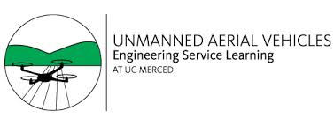



Autonomous Solutions: Unmanned Aerial Vehicles
Fall 2015
Advisor: Dr. Yang Quan Chen

Slide 2
Mission Overview
Project: Leaf Scorching Detection
Partnering with the UC Cooperative Extension (UCCE), the team aims to design an autonomous solution for the detection of Pierce’s Disease.
Unmanned aerial vehicle and software solution package
Affordable Precision Agriculture
Operation yields small carbon footprint
Simplicity and Sustainability

Slide 3

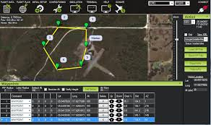
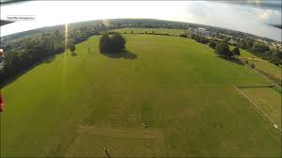
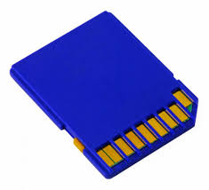
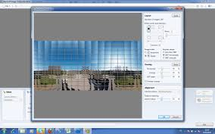

Slide 4
Accomplishments
3D Printed gimbal and camera case
Settings optimized for stitching process (Hugin/Microsoft ICE)
Wrote a Batch script to begin and output stitched files
New Analysis code using NDVI
Developed fully functional GUI

Slide 5
Project Impact
Economic Impact
Who will Benefit?
Pierce’s Disease costs farmers an estimated total of $104.4 million per year in California.
Loss of production
Vine replacement
Disease Research
Local, small-scale vineyards will see biggest impact.
Increased seasonal yields w/ lower costs
Better disease detection and crop management
Notes:
Pathogen: Bacteria
Vector: Glassy-winged sharpshooter (insect)
Symptomatic characteristics:
Early in crop cycle: stunted growth but not necessarily discoloration
Later in crop cycle: Leaf discoloration and damage due to vessel damage
Vine-to-vine contamination is rare and currently insignificant
Farmers will be able to detect possible threats before they become catastrophic to their entire crop. The finished product should be a cost-effective compared to alternative existing methods; farmers can optimize their labor resources (time and money) in the detection of diseased crops.

Slide 6
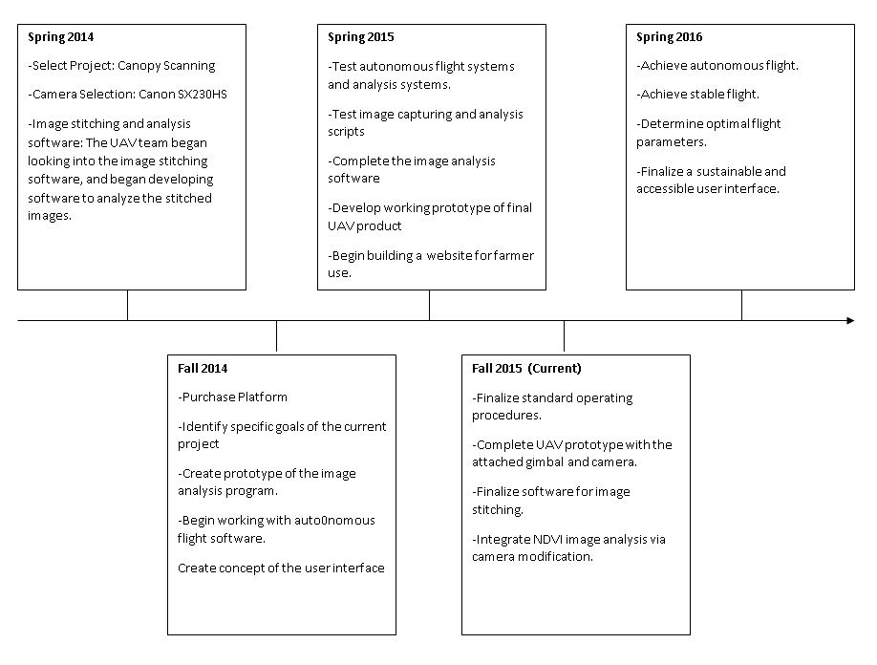
Overall Project Timeline

Slide 7
Current Phase and Semester Goals
Phase Four: Detailed Design
Developed a complete working prototype, ready for testing
Fully functional imaging software and platform
Platform Subteam
Imaging Subteam
Modify camera to take IR images.
Mount camera to platform in such a way that the camera lens is normal to the earth’s surface.
Prepare platform for autonomous flight.
Optimize flight path and/or camera setting to expand on the reliability of the image-taking platform.
Automate the post-flight image analysis process
Optimize and expand capabilities of analysis code
Address image stitching errors within our current implementation
Creates simple output interface for displaying the final results and relevant information to the user
Notes:
Platform Team Goals
1. Modify camera to take IR images.
2. Mount camera to platform in such a way that the camera lens is normal to the earth’s surface.
3. Prepare platform for autonomous flight.
4. Optimize flight path and/or camera setting to expand on the reliability of the image-taking platform.

Slide 8
Challenges/Solutions
Prior semester’s code was written in C++, we needed to convert all code to Java before we could create our executable JAR files
Not able to fly the drone on campus for testing
Solution: use a flag pole and mount our camera for sample images
Take photos of vegetation/rot and perform analysis on sample images
Old program that used HSV values/thresholds did not account for shadows or change in terrain and could provide misleading results.
Solution: switch to NDVI
Modify camera by disassembling and removing IR filter and installing Cannon Hack Development Kit (CHDK)
Our main image stitching program, Microsoft Ice, is not available on Mac or Linux.
Solution: researched other free alternatives such as Hugin and tested/received similar results

Slide 9
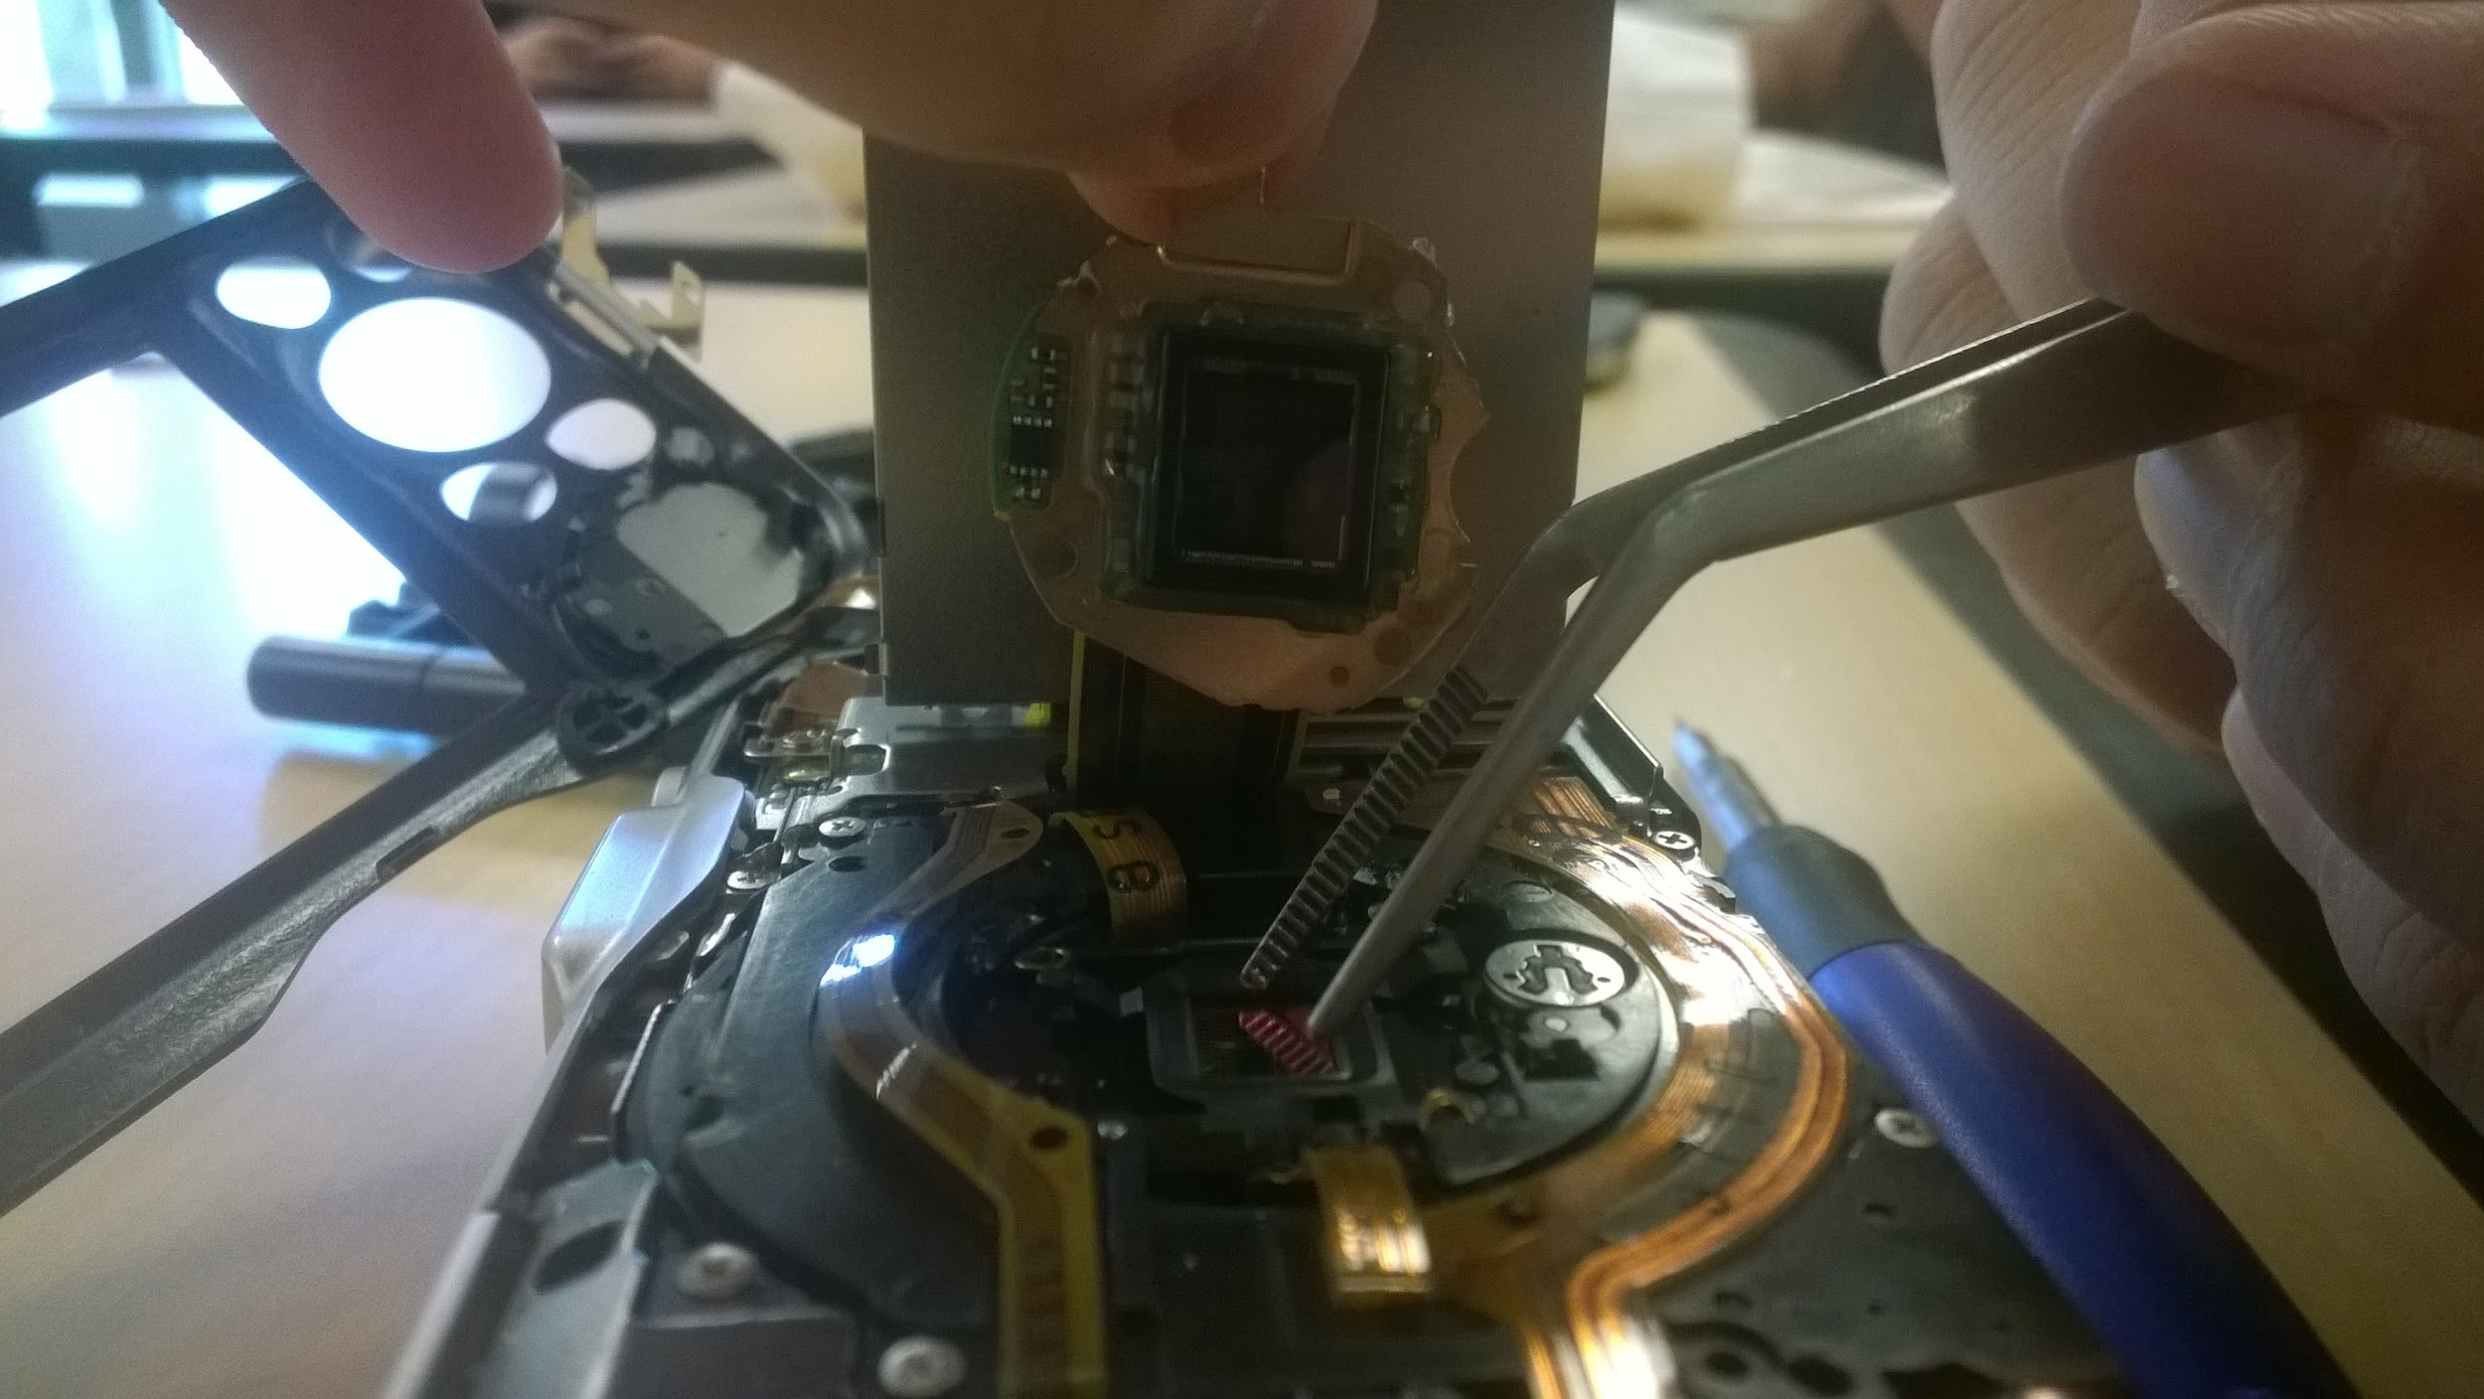
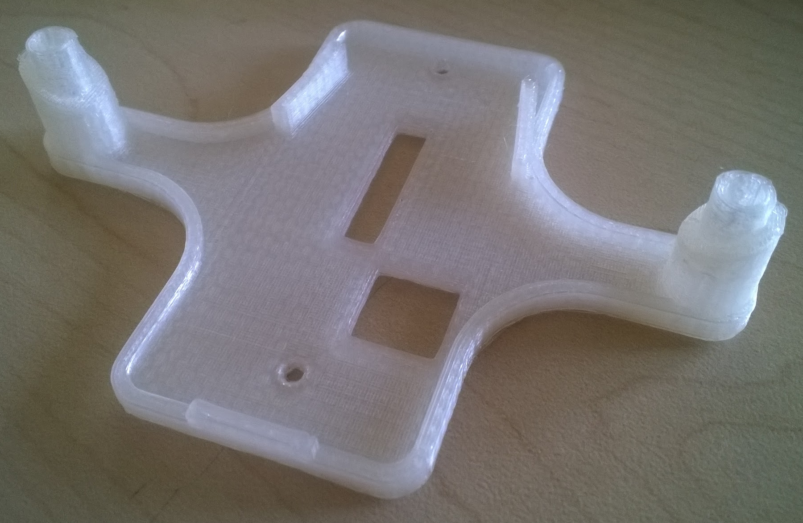
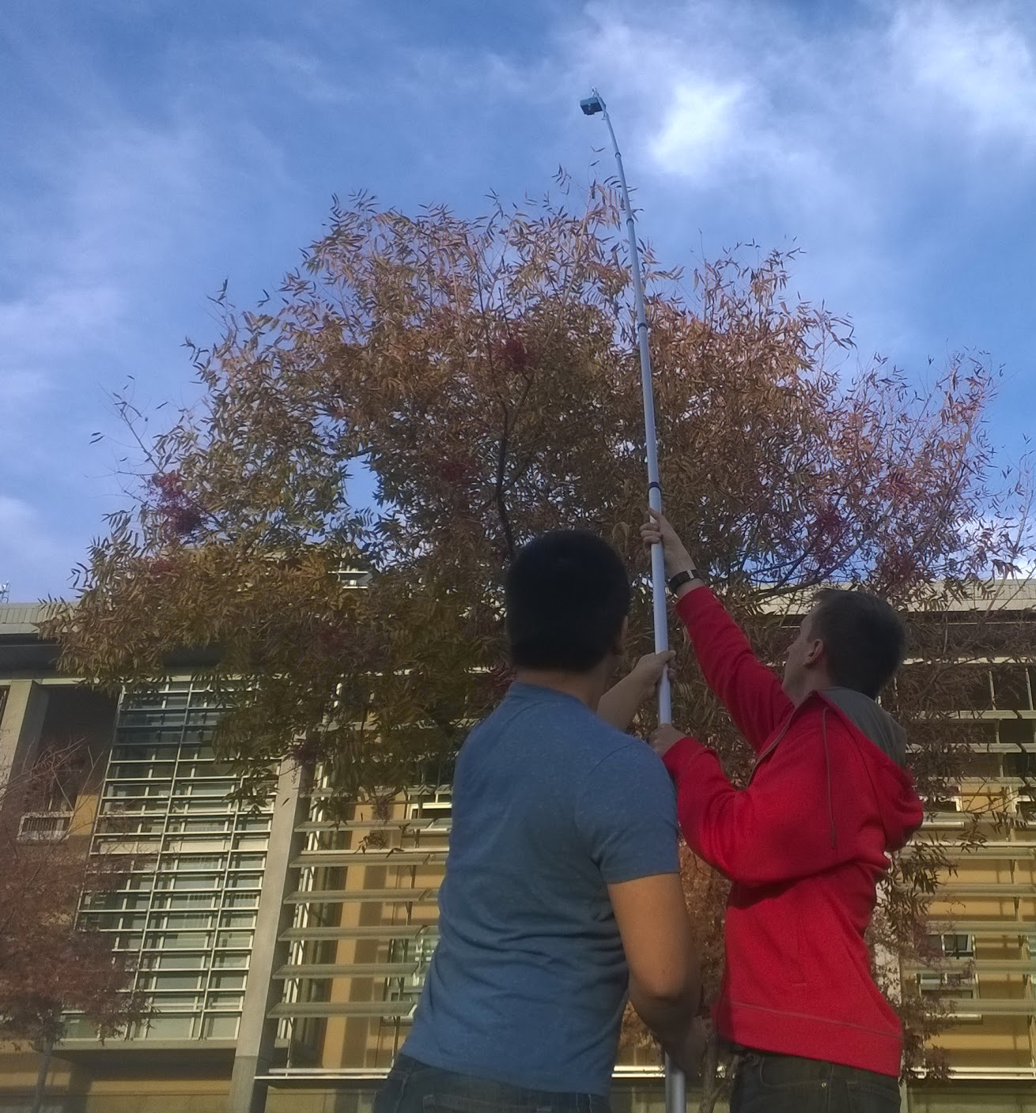
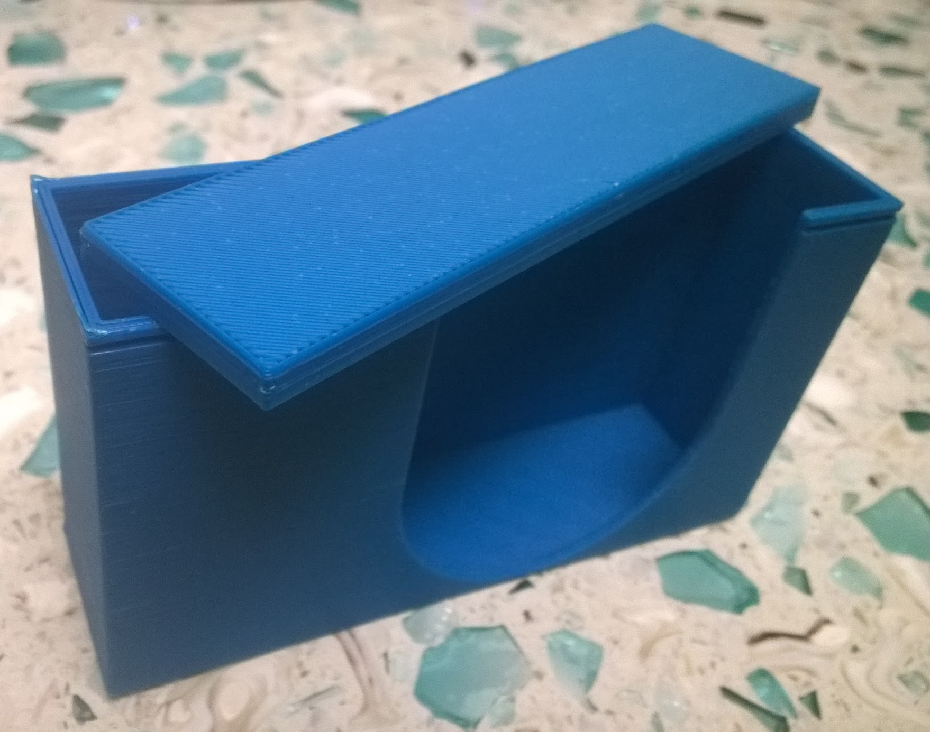
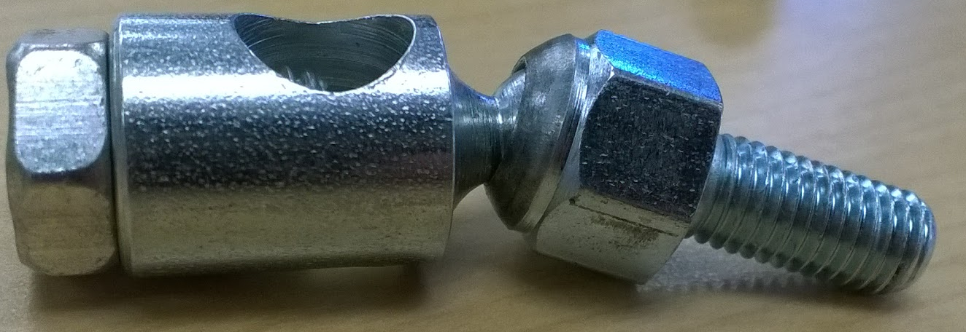
Notes:
Poss. platform slide

Slide 10
Fall 2015 Semester Timeline
10/13
3D Printed gimbal + Converted C++ reference
11/10
Completed script files + 3D printed camera case
8/24
Project Start
11/24
Gimbal tested with flagpole
12/11
completed phase 4
9/29
Began flight training + Began initial writing of scripts
10/27
Camera firmware installed and updated with script
11/17
tested analysis code and analyzed NDVI output + Acquired remaining gimbal parts
12/8
Gimbal completed and mounted + Final script completed

Slide 11
Processing Software
1.) Stitch
Create a single large map from collection of aerial images
2.) Analyze
Use NDVI to locate and highlight bad crops
3.) Present
Show the analysis and relevant information in an aesthetically pleasing way
Output information to PDF

Slide 12
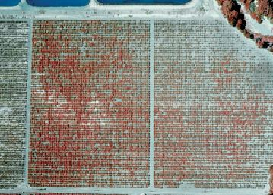
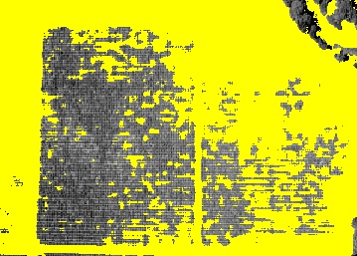
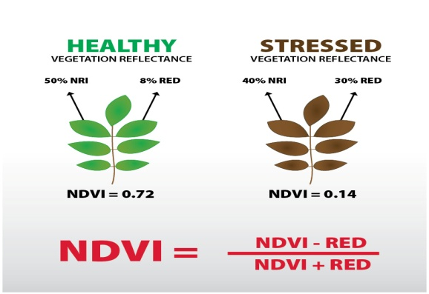
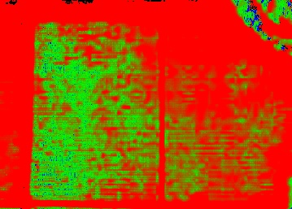
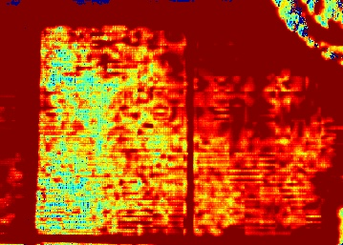
Analysis Technique

Slide 13
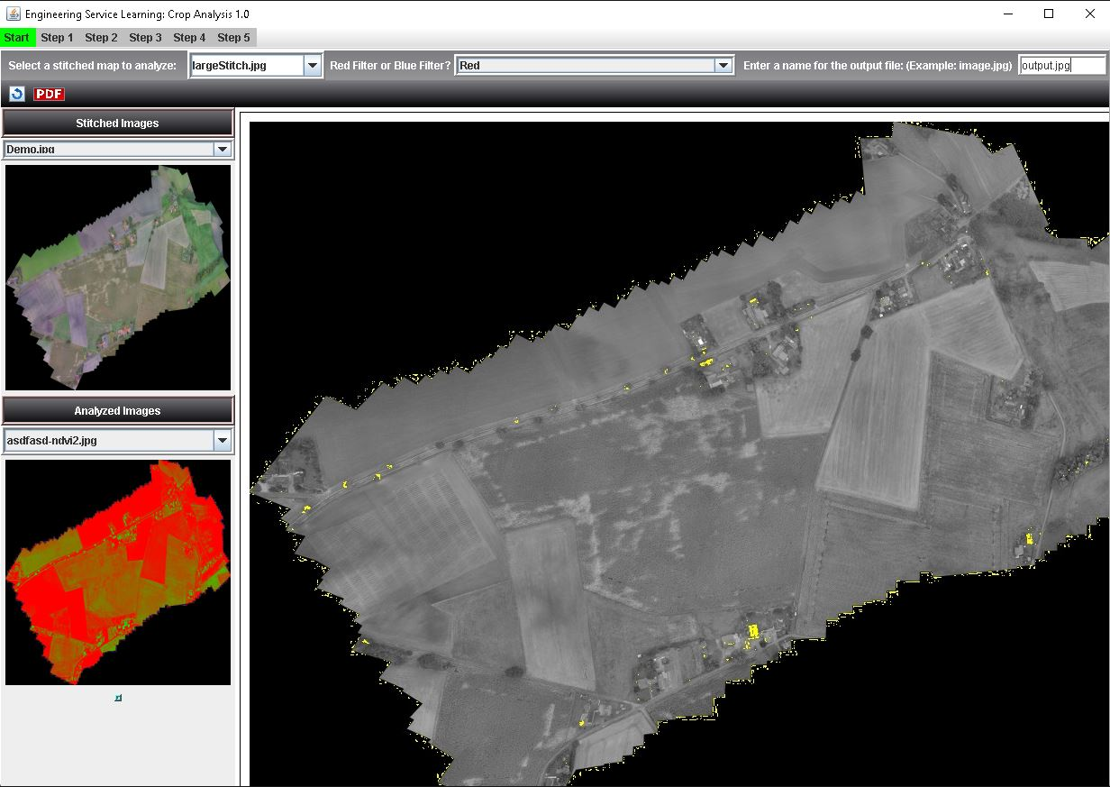

Slide 14
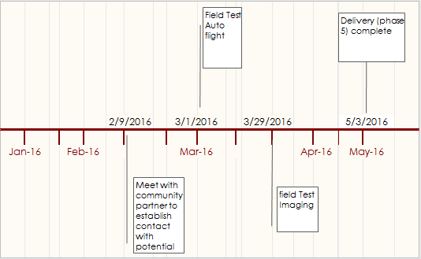
Spring 2016 Semester

Slide 15
Spring 2016 Projected Tasks
Overall Goal: Complete Phase 5 (Delivery)
Meet with Community Partner to present prototype
Survey specific sample groups to see if our interface is easy to use
Connect with potential 3rd party for field testing
Test Autonomous flight and imaging analysis process
Determine modifications needed to be made to code or drone

Slide 16
Future of the UAV Project
The applications of the prototype can be extended to multiple crop types:
Almond leaf scorch
Oleander leaf scorch (OLS)
Alfalfa dwarf
After this semester’s prototype is completed, there will likely be areas of opportunity to be addressed:
Increased battery life/flight time
Flight Stabilization

Slide 17
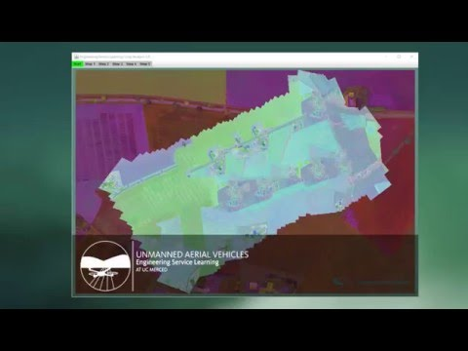
Program Demo
View Demo Here

Slide 18
Thank you!
Fall 2015
Advisor: Dr. Yang Quan Chen

